Slide 1

Cab Price Predict
A model that predicts cab prices
By: Adanma Okafor

Slide 2
Introduction
The primary expected outcome is to build a predictive model that can accurately estimate ride-hailing prices. The model should minimize prediction errors and enable ride hailing companies provide fare estimates that are accurate and in line with the actual prices.
This will provide a competitive advantage to the company in the ride-hailing market as being able to offer competitive and transparent pricing can attract and retain customers.
It would also result in an improved customer experience and satisfaction as accurate predictions reduces the likelihood of surprise price changes.

Slide 3
Performance Matrix
Mean Absolute Error (MAE): this measures the average absolute difference between predicted prices and actual prices. It will give a sense of how far off, on average, the predictions are from the actual prices.
Interquartile Range(IQR): the interquartile range of the prediction errors helps to assess the spread of errors around the median. In ride-hailing, there might be occasional extremely high or low prices due to surge pricing, special events or other factors. Using IQR can help to understand the typical price range without being heavily influenced by these outliers.
Median Absolute Error (MedAE): is the median of the absolute differences between predicted and actual prices. Like IQR, It’s also less sensitive to outliers compared to mean-based metrics and can help reflect consistency in pricing.

Slide 4
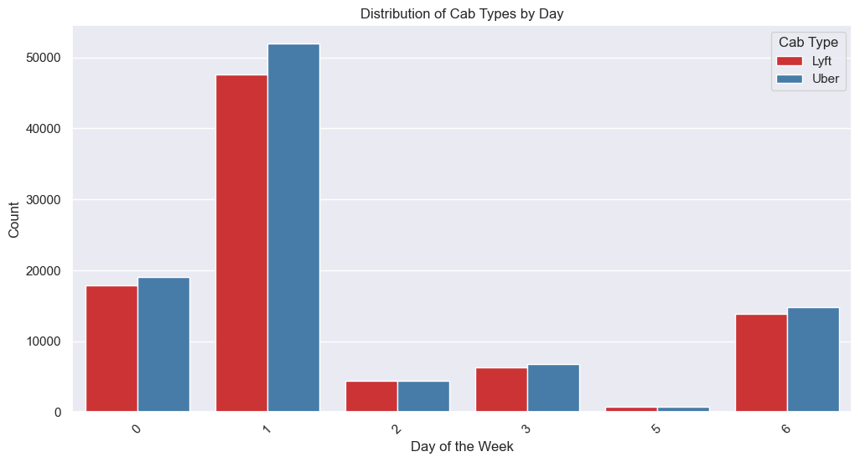
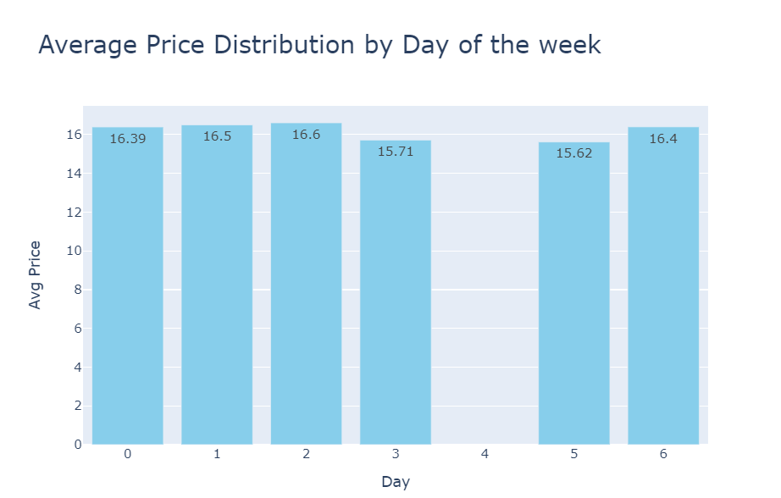
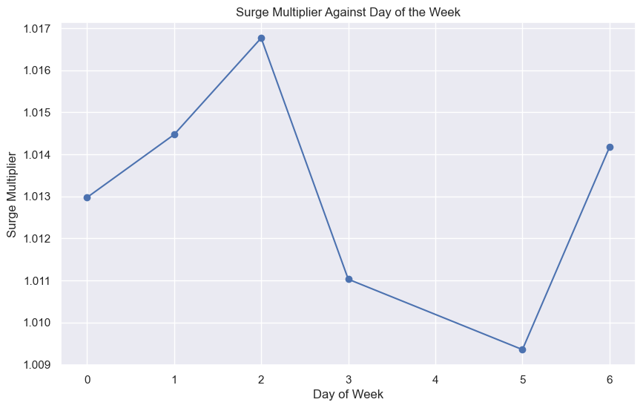
Descriptive Analysis
Uber was identified as the most ordered cab type.
Mondays have the highest number of cab orders and lowest orders on Fridays.
Surge is highest on Tuesdays and lowest on Saturdays.
Surge is highest at around 8pm and lowest around 4pm.
On average, the most money is made on Tuesday and the least on Saturday.

Slide 5
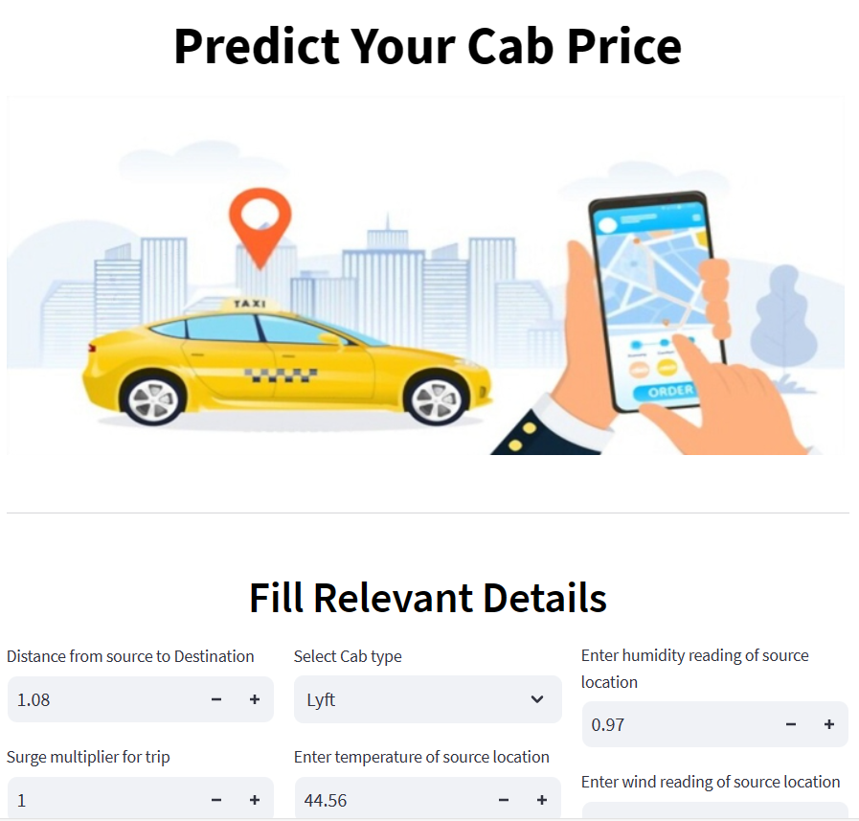
After evaluation of different algorithms, the LinearRegressor was chosen as the most suitable model to be used
A price predictive app was then developed utilizing streamlit
Relevant information related to the trip needs to be entered

Slide 6
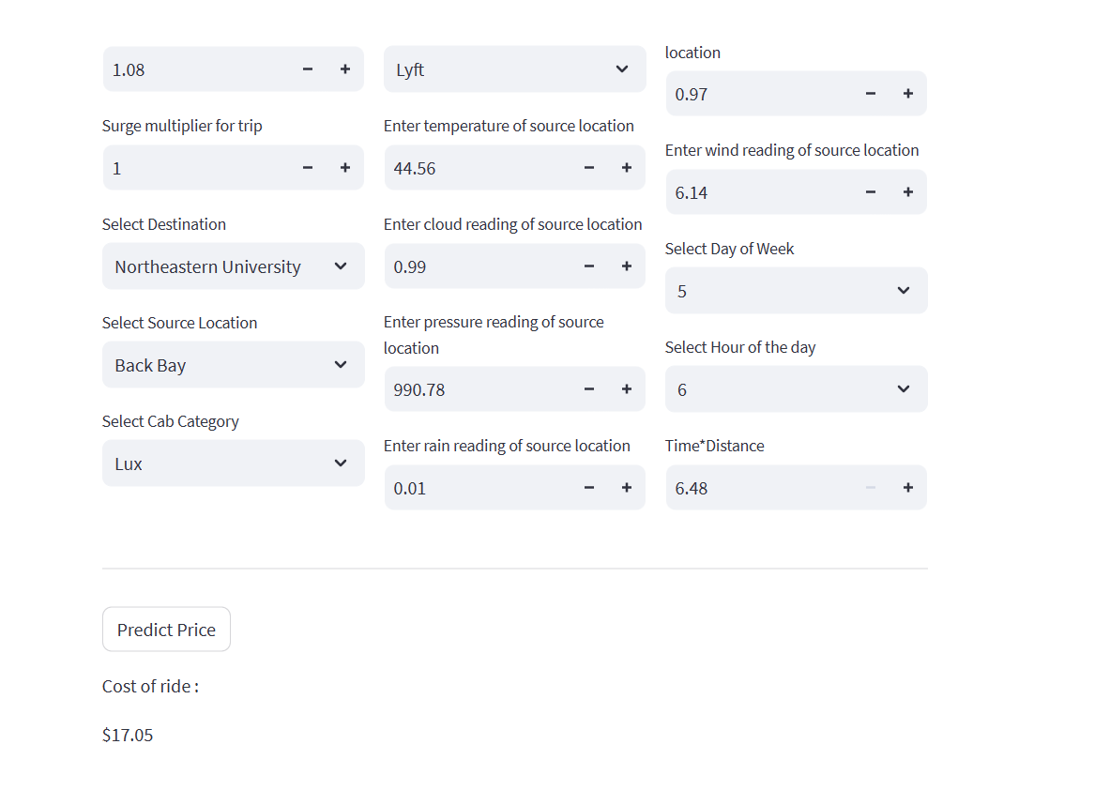
After all relevant information is filled, the Predict Price is then clicked to give the predicted price of the trip in USD

Slide 7
Further/Future Projects
Demand Forecasting
Understanding patterns in ride requests and how they vary by location, time, and external factors, can help build models for demand forecasting in the ride-hailing industry. This can enable companies allocate resources more efficiently.

